Slide 1
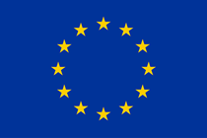
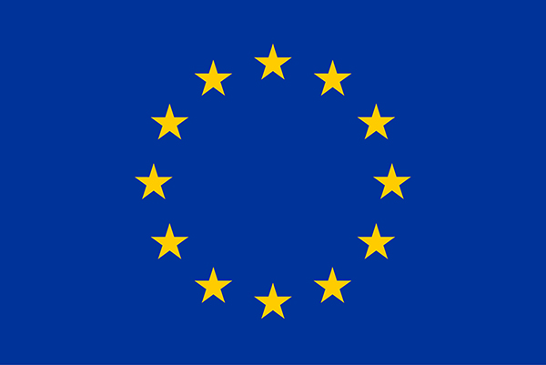
HOW THE EU WORKS

Slide 2
MEMBERS OF EU
There are 28 Member States of the European Union. (Austria, Belgium, Bulgaria, Croatia, Cyprus, Czech Republic, Denmark, Estonia, Finland, France, Germany, Greece, Hungary, Ireland, Italy, Latvia, Lithuania, Luxembourg, Malta, The Netherlands, Poland, Portugal, Romania, Slovakia, Slovenia, Spain, Sweden and the United Kingdom).
The EU has an agreement called the European Economic Area (EEA) agreement with Iceland, Norway and Liechtenstein. This agreement means that many of the rights of citizens of the EU also apply in these countries.

Slide 4
THE INSTITUTIONS OF THE EU
The institutional organisation of the European Union (EU) is unique and differs radically from the institutions of its 28 Member States. There is no single president, nor any European prime-minister, and not even a single European government in charge. Every institution has its own structure, members and specific place among the other European institutions.
There are seven EU institutions : The European Council The Council of the European Union (also "the Council") The European Commission The European Parliament The Court of Justice of the European Union The Court of Auditors The European Central Bank

Slide 5
Irelands MEPs

Slide 6
Lynn Boylan
For Lynn Boylan suitable development means assisting countries or communities.
It means helping social, economic and environmental way.
In her mind eradicating extreme hunger and poverty must be a prime goal.

Slide 7
Matt Carthy
In his eyes to achieve any sort of sustainable future we must begin to see development as a priority of global security.
Matt says that it is anticipated that oil reserves will run out within the next 100 years.
He also says that global warming and environmental decay have severely impacted on communities around the world

Slide 8
Deirdre Clune
Goal to set a good government and environment for future generations
Wants equal trade and development throughout all countries to hopefully solve climate change
Strongly suggests that we need to preserve this world to make sure it continues on

